Slide 1
ATHLETIC PERFORMANCE
Los Angeles Harbor College;

Slide 2
ATHLETES
Skill
Nutrition
Confidence & Mental Toughness
Strength & Speed
Flexibility & Agility
Stamina
Focus & Motivation

Slide 3
ABOUT BEING CHAMPIONS
This is the beginning of a new day. I was given this day to use as I will. I can waste it or use it for good. What I do today is important because I am exchanging a day of my life for it. When tomorrow comes, this day will be gone forever, leaving in its place something I have traded for it. I want it to be gain, not loss; good, not evil; success, not failure; in order that I shall not regret the price I have paid for it.
The price of greatness is RESPONSIBILITY!
https://www.youtube.com/watch?v=jbmVgCt3Hgw

Slide 4
Athletic performance
Skill
Focus & Motivation
BE EARLY
100% EFFORT
Confidence & Mental Toughness
BE COACHABLE & ENCOURAGE OTHERS
PERSIST & 100% ACCOUNTABILITY
Strength & Flexibility (Mon-Wed)- Aerobic/WT RM
Speed & Agility (Tues-Thurs)- FOOTBALL FIELD
Stamina

Slide 5
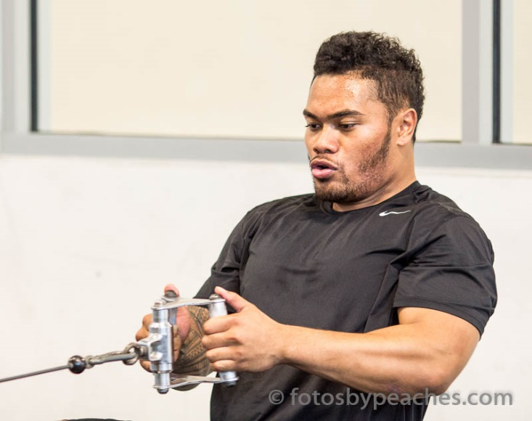
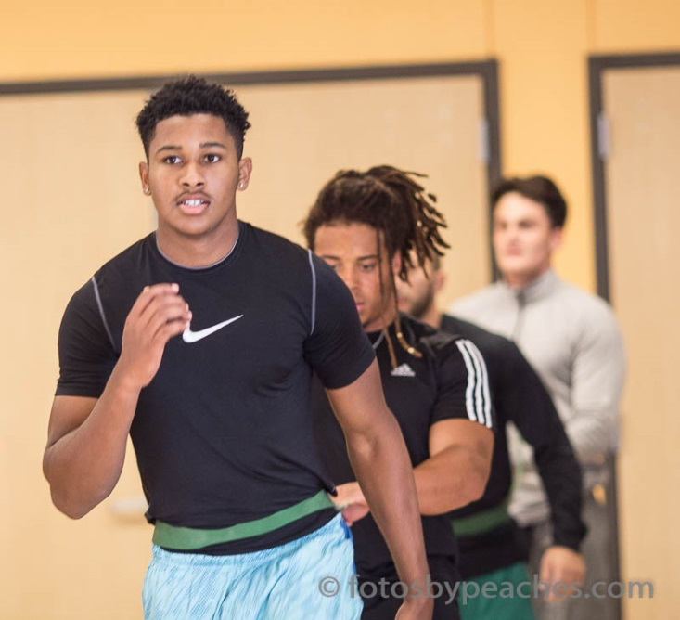
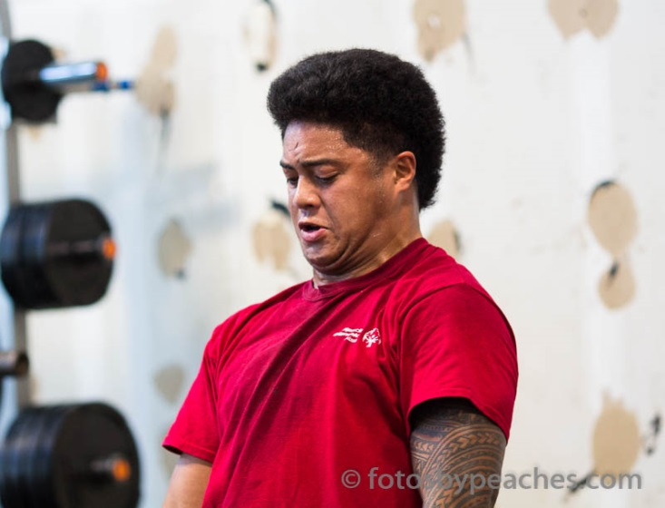
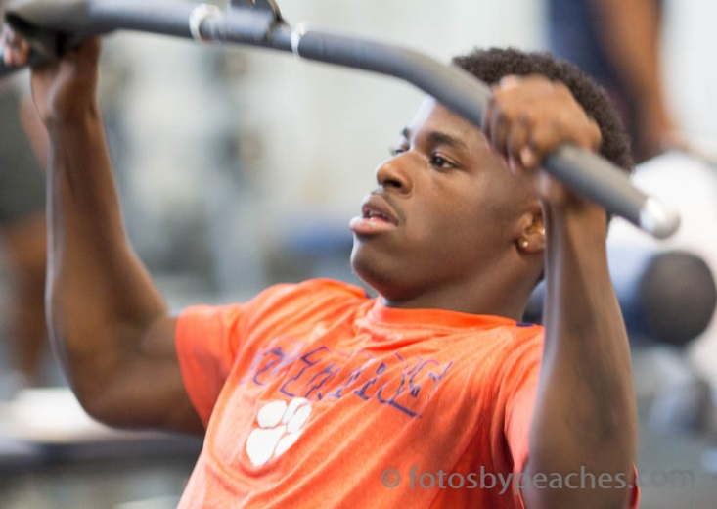

Slide 6
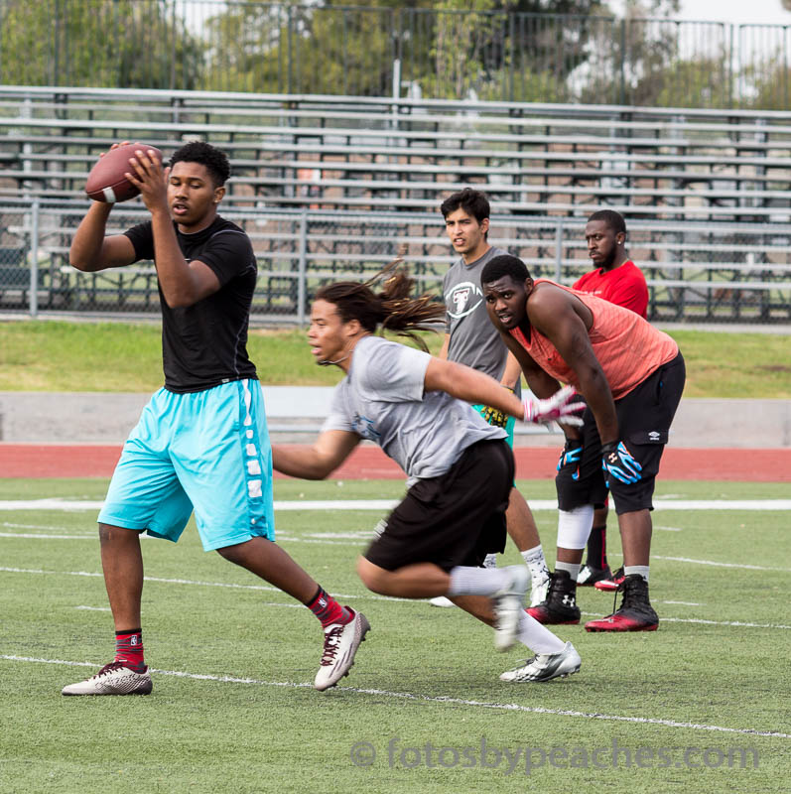
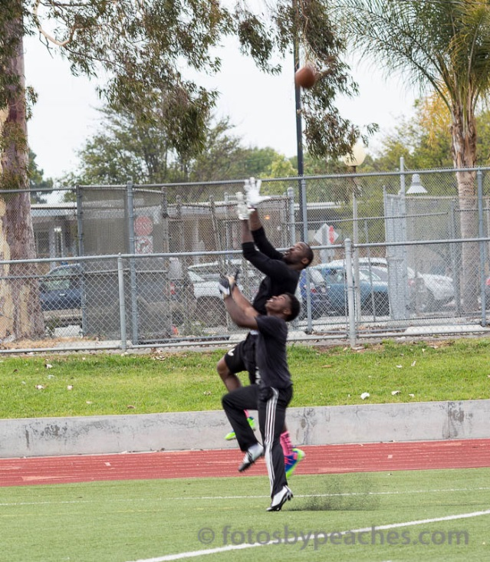
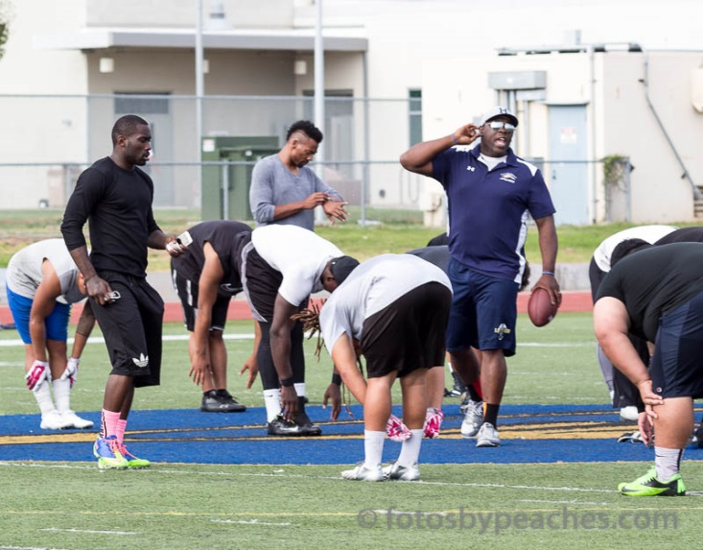
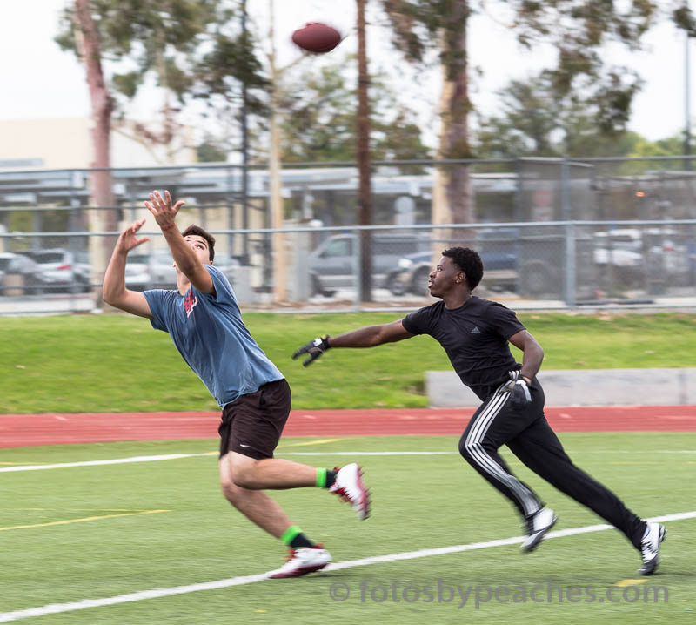
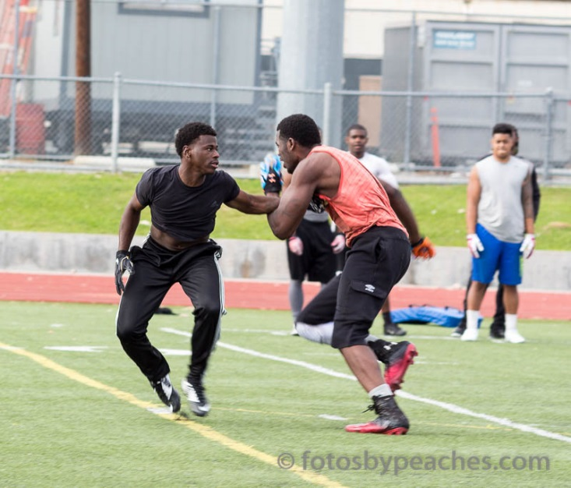

Slide 7
NUTRITION
Breakfast (7am)
Within an hour of waking up.
At least 20gms protein
Eggs, bacon, sausage, pancakes, oatmeal, steak bits, protein shake
Snack (10am)
Nuts, fruit, veggies, cheese, chicken, protein bar/drink, eggs
Lunch (1pm)
PB&J, Turkey, Chicken, Roast Beef, Pastrami Sandwiches
Hamburgers and Hot Dogs
Nuts, fruit, veggies, cheese
TEAM TRAINING (2:30pm)
Snack (4:30pm)
Recovery shake, Nuts, fruit, veggies, cheese, chicken, protein bar, eggs
Dinner (7:30pm)
Chicken, rice, beans, quinoa, steak, salad, spaghetti, lasagna, fish, etc.
Snack optional (10pm) if trying to gain muscle mass
GO TO BED BY 11pm

Slide 8
RECOVERY
At least 7 hours of sleep
Recovery starts at 10:30pm
Testosterone, HGH, protein resynthesizes, memories, healing properties
Multi-vitamin, Omega’s, Vitamin E, Vitamin C
Friday
Light recovery: stretching, foam rolling, hot/cold
Saturday
Active recovery: bike, jog/walk, swim, yoga, pilates, FB
Sunday
Light Active recovery: bike, walk, swim, yoga, pilates

