Slide 1
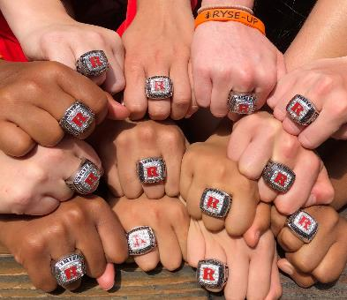
Building a Championship Legacy
Professor/Coach Leslie “C” Trujillo
@dearherproject
www.professortrujillo.com
www.dearherbook.com

Slide 2
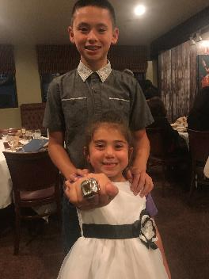
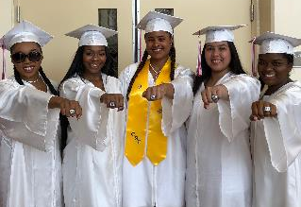
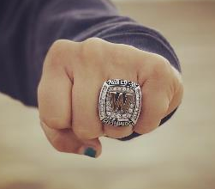
Be an MVP
Mindset-Vision-Performance

Slide 3
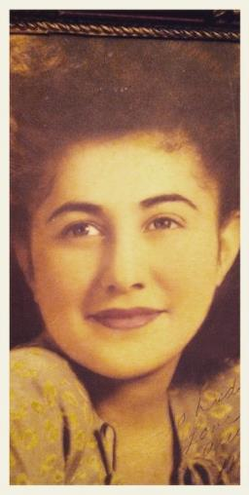
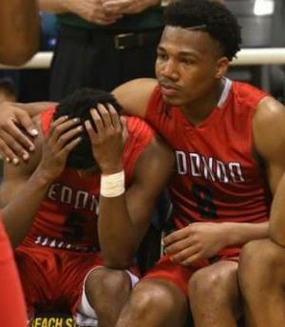
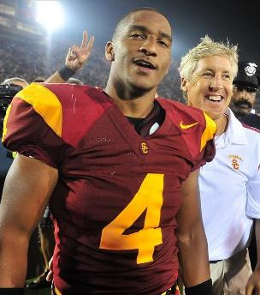
Ryse Up & Believe

Slide 4
One Shining Moment

Slide 5
What do Champions do to Succeed:
BET on Themselves
Believe
Execute
Trust
Coachable
Character
Compete
Confidence
Championship Mindset

Slide 6
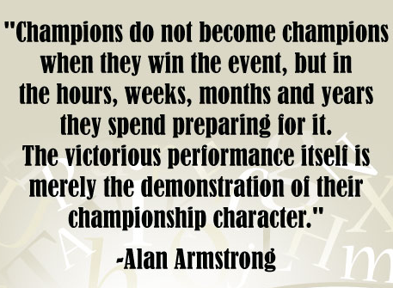
Putting it all together
Pre-Season
Evaluations
Goal-Setting
Preparation is High
In-Season
Competition is High
Walk through
Pre-Game Routine
Time-Outs
Half-Time
Post-Game
Post-Season
Regeneration is High
Review & Strategize

Slide 7
WHY- HOW WHO- WHAT

Slide 8
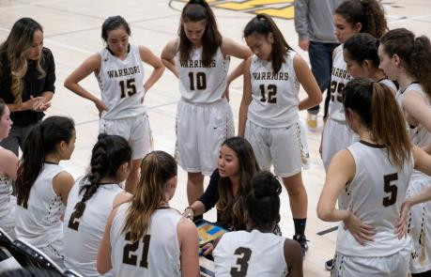
Coachable

Slide 9
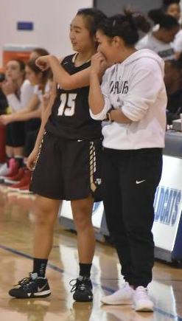
Character

Slide 10
Compete
Notes:
Long Term Athlete Development Model: 10-Year Rule, Deliberate Practice and Perseverance
Goal is life-long athleticism. Reverse engineering template to break it down to build it up. Focus on Progression.

Slide 11
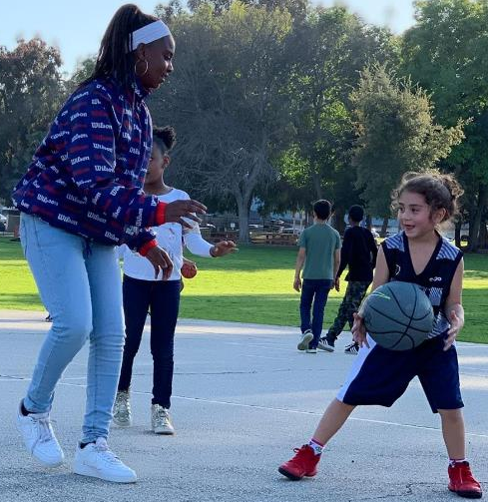
Confidence
Notes:
Vision: What you want to create
Make a decision & state it.
State it as if it has already happened.
Re-write goal everyday
“I’m grateful I remained positive throughout the season”
Affirmation: One phrase to describe you (Power Statement)
Strong, powerful, easy to remember, feels true to you
Say it every day. Replace negative thought
“I have inside me everything I need to succeed.”
“I overcome. I dominate. I succeed. I have it all.”

Slide 12
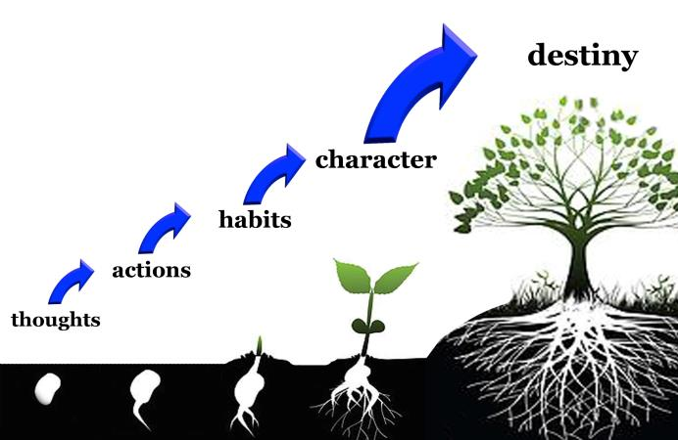
Championship Mindset
Visualize- Faith & Gratitude- Consistent Action
Notes:
Thoughts chunk to movement. You want to be great at something- train like it is easy, think like it is easy, believe that it is easy. How we move is linked to what we think and feel. Quality of movement is dependent on the quality of the map. High level of intensity in a sequence can cause a new chunk to happen almost immediately. Sometimes you have to create momentum to get out of pain chunk. Most of the chunks we have are not based in reality. No longer true but we own them. Sometimes we are comfortable in the negative chunking. Pick 1 thing that is different that you’ve always done and it automatically starts to change the chunk.

Slide 13
Upgrade Habits

Slide 14
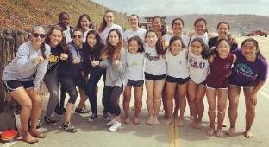
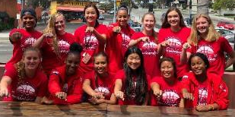
LEGACY
L- LOVE the lessons
E- You are ENOUGH
G- GRATITUDE is a way of life
A- ATTENTION to your thoughts
C- Control your CHOICES
Y- YOU are Unique

