Slide 1
WELCOME
END OF THE YEAR CELEBRATION 2019

Slide 2
THANK YOU
President Lee, VP’s, Administration & Professors
Dr. Bobbi Villalobos & Dr. Luis Dorado
Roxana Hernandez
Dr. Edward Pai & Nabeel Barakat
Nadine Muro and Lori Minor
Norma Torres, CHAMPS Counselor
CHAMPS Supervisors: Joseph Jimenez and Jeysen Delgado
CHAMPS Tutors
Athletic Director, Dean Dowty
Head Coaches and Assistant Coaches
Athletic Trainers and Athletic Staff:
Christol McDonald, Billy Velasco, Patrick McNeal, Lynn McGuire, Maria Navarro

Slide 3
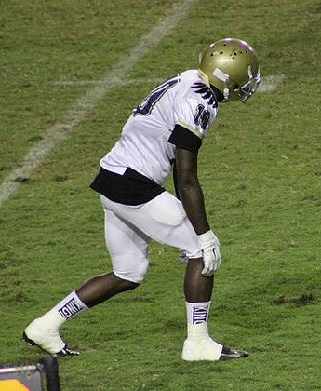
VISION:
CHAMPS develops CHAMPIONS in education, in sport, and in life for student-athlete success.

Slide 4
GOALS:
Students graduate within 2 years and earn a scholarship to a 4-year University
Improve study skills & GPA
Decrease drop out rates
Increase retention & completion
Celebrate the success of our S-A
Give back through community service
Develop leaders and life-long learners
Develop Championship Teams
https://www.youtube.com/watch?v=9z4Kft47kBM

Slide 5
STUDENT-ATHLETE AWARDS

Slide 6
CHAMPS- 2017-2018
STUDENT-ATHLETES OF THE YEAR
M Cross Country: Ariel Conde
W Cross Country: Andrea Gonzalez
Football: David Carter
Men’s Soccer: Ariel Vasquez
Women’s Soccer: Gicelle Magdaleno
Volleyball: Stephanie Mata’afa
Men’s Basketball: Henry Johnson
Women’s Basketball: Kristy Takahashi
Baseball: Fernando Rivas
Softball: Natalie Saucedo Fr.

Slide 7
CHAMPS- 2018-2019
STUDENT-ATHLETES OF THE YEAR:
M CROSS COUNTRY
W CROSS COUNTRY
FOOTBALL
M SOCCER
W SOCCER
VOLLEYBALL
M BASKETBALL
W BASKETBALL
BASEBALL
SOFTBALL

Slide 8
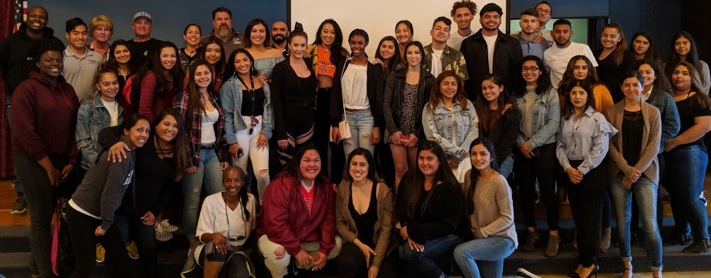
CHAMPS- TRANSFERS
CONGRATULATIONS TO ALL OUR GRADUATES AND TRANSFERS!
CONTINUE TO BE GREAT IN ALL THAT YOU DO!

Slide 9
TEAM REVIEW & AWARDS

Slide 10
BASEBALL
ATHLETE OF THE YEAR
MOST IMPROVED
COACHES LEADERSHIP AWARD

Slide 11
SOFTBALL
ATHLETE OF THE YEAR
MOST IMPROVED
COACHES LEADERSHIP AWARD

Slide 12
M BASKETBALL
ATHLETE OF THE YEAR
MOST IMPROVED
COACHES LEADERSHIP AWARD

Slide 13
W BASKETBALL
ATHLETE OF THE YEAR
MOST IMPROVED
COACHES LEADERSHIP AWARD

Slide 14
WOMEN’S SOCCER
ATHLETE OF THE YEAR
MOST IMPROVED
COACHES LEADERSHIP AWARD

Slide 15
MEN’S SOCCER
ATHLETE OF THE YEAR
MOST IMPROVED
COACHES LEADERSHIP AWARD

Slide 16
VOLLEYBALL
ATHLETE OF THE YEAR
MOST IMPROVED
COACHES LEADERSHIP AWARD

Slide 17
FOOTBALL
ATHLETE OF THE YEAR
MOST IMPROVED
COACHES LEADERSHIP AWARD

Slide 18
M X- COUNTRY
ATHLETE OF THE YEAR
MOST IMPROVED
COACHES LEADERSHIP AWARD

Slide 19
W X- COUNTRY
ATHLETE OF THE YEAR
MOST IMPROVED
COACHES LEADERSHIP AWARD

Slide 20
CHAMPS-
THANK YOU
The pain of discipline is far less than the pain of regret. You owe it to yourself to be the best you can possibly be – in athletics, education, and in life.

