Slide 1
COMPLETE GUIDE TO FITNESS & HEALTH- Chapter 3
ACSM, 2ND EDITION
KIN 010- LAHC
PROFESSOR TRUJILLO

Slide 2
KEY IDEAS FOR CHAPTER 3
Dietary Guidelines for Americans:
Follow a healthy eating pattern across the lifespan.
Focus on variety, nutrient density, and amount.
Limit calories from added sugars and saturated fats and reduce sodium intake.
Shift to healthier food and beverage choices.
Support healthy eating patterns for all.
MACRONUTRIENTS:
Fat: 9kcal/gm
Protein: 4kcal/gm
Carbohydrates: 4kcal/gm
Water: 0kcal/gm
MICRONUTRIENTS:
Vitamins & Minerals

Slide 3
Daily caloric intake

Slide 4
Myplate.gov

Slide 5
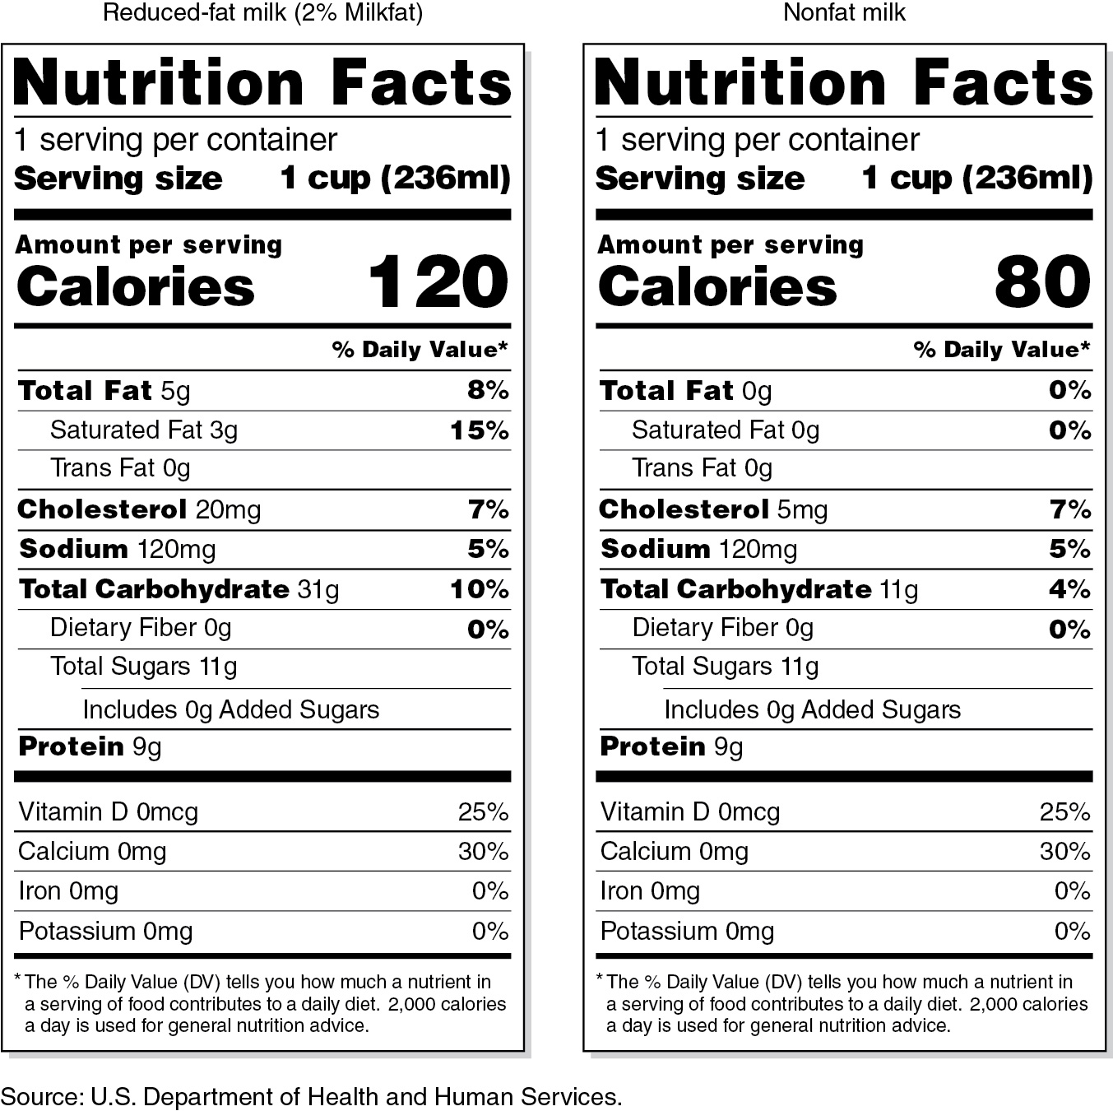
Food labels

Slide 6
protein

Slide 7
Carbs & FIBERS

Slide 8
fats

Slide 9
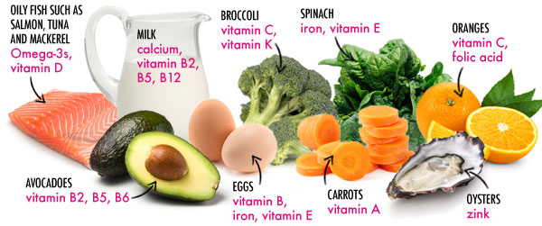
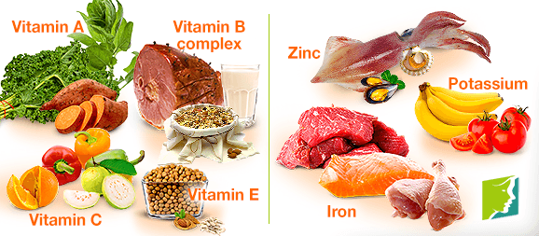
Vitamins and minerals

Slide 10
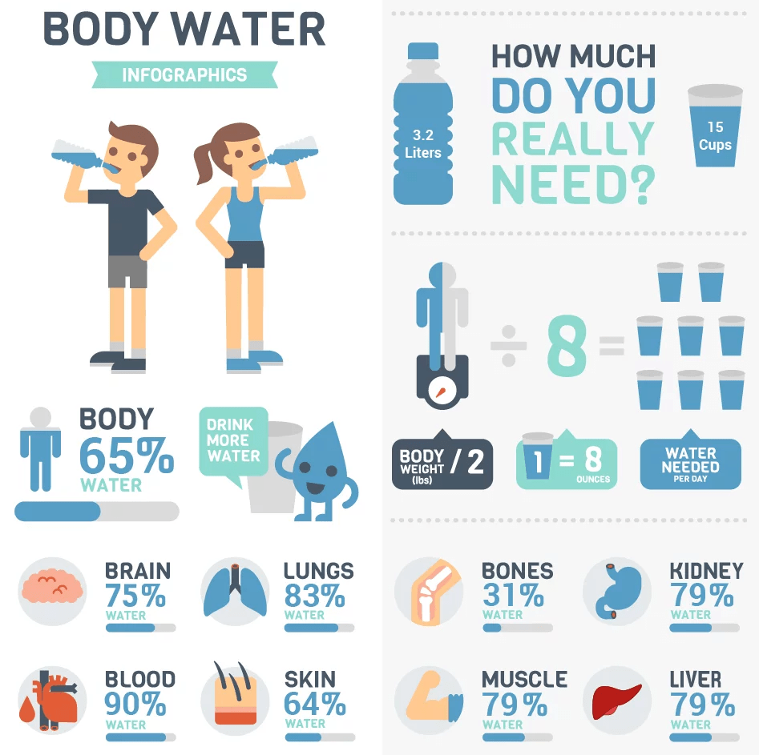
Water- ½ of your bw in ounces

