Slide 1
LIFELONG WELLNESS: AN APPLIED APPROACH

Slide 2
MODULE 1
SETTING ACHIEVABLE WELLNESS GOALS

Slide 3
DEFINING WELLNESS & DEVELOPING LIFELONG WELLNESS GOALS
Wellness:
The state of well-being that includes a process of change and growth to reach your full potential
Interaction of several dimensions of wellness, including physical, emotional, intellectual, spiritual, social, and environmental wellness

Slide 4
DIMENSIONS OF WELLNESS

Slide 5
DIMENSIONS OF WELLNESS
PHYSICAL WELLNESS
Behaviors that keep you safe, such as safe sex, avoiding the use of drugs and alcohol, and wearing a helmet when riding a motor cycles.
Getting a regular physical at your doctor’s office is also part of healthy behaviors that will promote your overall health.

Slide 6
EMOTIONAL WELLNESS
EMOTIONAL WELLNESS
Ability to cope with life’s challenges without extreme ups and downs.
Ability to express and communicate your emotions and understand other people’s emotions, feel compassion, and empathy.
How we perceive ourselves, our self-esteem, and self-efficacy and it can be influenced by all the other aspects of wellness as well.

Slide 7
INTELLECTUAL WELLNESS
INTELLECTUAL WELLNESS
Choices you make to maintain and grow your intellectual potential throughout your life span.
Your desire to challenge your thinking process, your ideas, your curiosity to learn new things, and interact with people who have different points of views and different beliefs from yours.

Slide 8
SPIRITUAL WELLNESS
Refers to your ethics, your moral values, and beliefs. It is a broad concept that goes beyond religion. Spirituality and religion have features in common, but are different in many aspects.
RELIGION: Sets of practices, beliefs, and worship in a higher power often in the form of God or Gods.
SPIRITUALITY: Constant examination, reevaluation of your own values, morals, and beliefs that keep evolving over time.

Slide 9
COMPARISON OF RELIGION AND SPIRITUALITY
RELIGION | SPIRITUALITY
Institution | Individual belief without rules or dogma
Organized belief system | Your way to relate to the world around you
Consequences for your actions | No consequences for your actions
Sets of norms and rules | Empowers you to find your own truth

Slide 10
SOCIAL WELLNESS
Your ability to create and maintain a support system with friends, coworkers, family, and significant others. It refers to the quality of meaningful relationships you create in your life.
It is your ability to communicate and interact with people around you.
Furthermore, social wellness is your understanding and respect of social norms.

Slide 11
ENVIRONMENTAL WELLNESS
Relates to the degree to which your actions and lifestyle affect the health of your community, other species, and the planet. It includes the way you contribute to the quality of water, land, and air.
Environmental wellness involves a sense of responsibility for your actions, and awareness of how the use of the earth resources affects the lives of others. Our behaviors toward our environment as a society eventually impact the quality of our own lives.

Slide 12
OCCUPATIONAL WELLNESS
Occupational wellness refers to the satisfaction you draw from your job; it is also the ability to contribute to your job’s success and the feeling that what you do is meaningful. It includes the satisfaction in your work, and the feeling of being supported and respected.

Slide 13
FINANCIAL WELLNESS
Financial wellness is your ability to recognize needs versus wants,
Your ability to spend within your means, and control your urge to spend irrationally or refuse to spend at the expenses of your needs.
Your ability to manage your money for current necessities and future goals.

Slide 14
WELLNESS QUESTIONNAIRE HOME WORK
HOW HEALTHY ARE YOU?

Slide 15
BEHAVIOR CHANGE
Optimal wellness is possible only once you are ready to change and ready to make sacrifices. Your desire to change will dictate your chances of success.
Goal setting is a common technique used to create change. Research indicates that people who set goals are more successful at reaching them than people who don’t.
We refer to the process as the stages of behavior change or the transtheorical model of change.

Slide 16
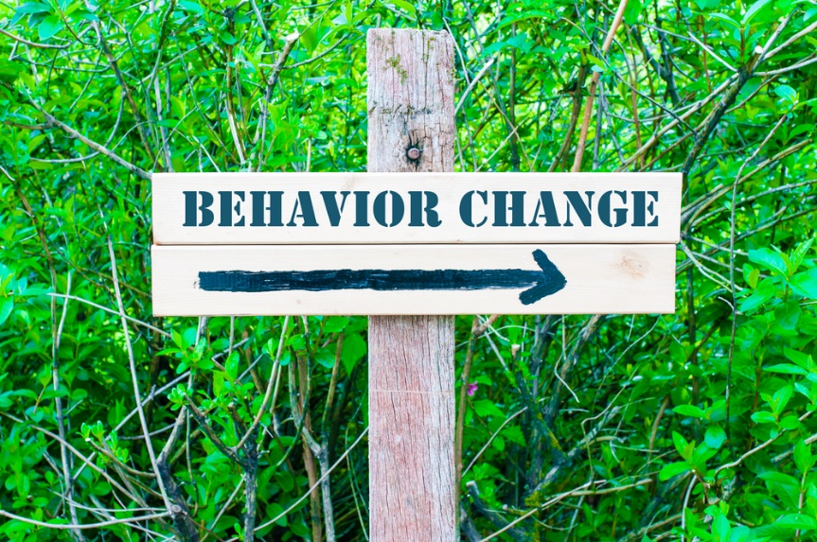
TRANSTHEORETICAL MODEL
Am I Really Ready To Change
Think about a health goal you’ve had or you have. While you watch the video, ask yourself in which stage you are.

Slide 17
HOW TO DEVELOP REALISTIC GOALS
There are several important steps to follow if you want to be successful.
Your big goal is your long-term goal, your vision.
It includes a starting and end date and a way to measure your progress and your success along the way.

Slide 18
STEP 1: DEFINING LONG-TERM GOALS
Your big goal is your long-term goal, your vision.
It includes a starting and end date and a way to measure your progress and your success along the way.

Slide 19
STEP 2: SHORT TERM GOALS
Your short-term goal is based on your long-term goal but with a shorter deadline.

Slide 20
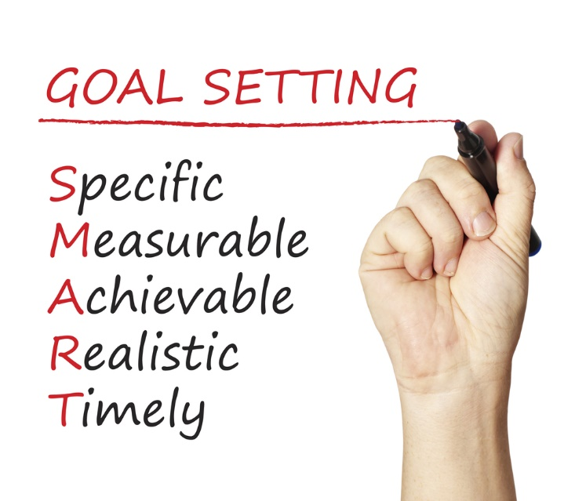
STEP 3: S. M. A. R. T. GOALS

Slide 21
S. M. A. R. T. GOALS
SPECIFIC (what)
“What” specifies things you are you going to do each week or each day in order to reach your short-term goal, “what” also defines your new daily habit?

Slide 22
MEASURABLE (when, how much, how often…)
When (measurable) are you going to do it? You have to make time within your schedule for the new habit, this means you may have to sacrifice something to accommodate the new action.
“When” also answer the question of when you are going to start your new habit, and the timeline to reach your short-term goal?

Slide 23
ACTION ORIENTED (how)
How will you accomplish that new behavior? “I will wake up 45 minutes earlier to run three to four times a week.” It clarifies the behavior that needs to take place in order to reach your goal.

Slide 24
WHY
Finally, it is crucial that you know why you want to reach this goal. Why do you want to start running? Is it to lose weight and improve your self-esteem, to improve your fitness level, to reduce your risks of diseases? Being able to know why you want to reach your goals is critical particularly in times when you feel like quitting. If you don’t have a clear reason for reaching your goal, then there is nothing to motivate you in the long run.,

Slide 25
REALISTIC
Can I realistically follow through with this new habits?
TIMELY
When will I start? When will I do it, what days, what time?

Slide 26
STEP 4: OVERCOMING BARRIERS
As you write your S. M. A. R. T. goals, you may find that things, people, or situation may get in the way.
STEP 5: SACRIFICE
Setting goals requires sacrifice. In order to get something, you have to “lose” something. Are you ready for the challenge? How will you rearrange your schedule to accommodate your new habits?

Slide 27
STEP 6: ASSESSING YOUR PROGRESS
Many people focus on the end result rather than on the overall progress. Look at what you have accomplished each week instead of one single point in the future.
Remember that ups and downs are not only normal, they are part of the process.
STEP 7: “DOING” IT
While setting goals is the first step, actually “doing” them requires commitment. A good question to ask yourself is “how much time have I spent on ‘doing’ or working on my goals?”

Slide 28
STEP 8: CREATING HABITS
Creating habits is probably the most important step in behavior change. Most of what we do throughout the day is based on habits.
Behaviors that have been repeated over and over for a long period of time become habits.
Once a habit is established, it becomes part of your lifestyle and no longer requires reminders, negotiation, or the same amount of effort. Think of your weekly goals as habits in the making.

Slide 29
CREATING HABITS
It has to occur on a regular schedule, same day, same time, and same duration,
You have to be able to complete the new tasks without interruption,

Slide 30
CREATING HABITS cont.
Bad habits can be replaced by better habits,
You have to keep the new habit even after you have reached your goal,
Using a power statement or an inspiring quote keeps you going.
End of Module 1

